Slide 1




Course name: Electrical & Electronics System (EE1002)
B.TECH FIRST YEAR
ACADemic YEAR: 2023-2024
Course code : EE 1002
lecture series no : 03 (THREE)
Credits : 04
Mode of delivery : oFF line (Power point presentation)
Faculty : Dr. Neeraj kanwar
Email-id : neeraj.kanwar@jaipur.manipal.edu
PROPOSED DATE OF DELIVERY: 23 Aug 2023

Slide 2
Session outcome
“ To understand the Non-Conventional Power Generation methods”

Slide 3
Assessment criteria’S
Assignment
quiz
mid term examination –I END TERM EXAMINATION

Slide 4

PROGRAM OUTCOMES MAPPING WITH CO1

Slide 5
Non-Conventional Power Generation Lecture No. 3

Slide 6
Contents
Topics:
1. Renewable energy resources
2. Solar energy
3. wind energy

Slide 7
Renewable energy resources
A renewable resource is defined as a natural resource that renews itself at a rate that is faster, or equal to the rate of consumption.
Renewable resources differ from resources that once depleted never return, such as fossil fuels. Renewable resources can include perpetually sustainable resources that never run out, such as solar power.
Renewable energy is energy generated from natural resources—such as sunlight, wind, rain, tides and geothermal heat—which are renewable (naturally replenished).

Slide 8
1. Solar Energy
The Earth receives an incredible supply of solar energy.
Solar energy is a free, inexhaustible resource.
Solar energy can be utilized directly by two technologies:
Solar thermal
Solar photovoltaic

Slide 9
Solar thermal System
Solar collectors are used to collect the solar energy and convert the incident radiations into thermal energy by absorbing them.
This heat is extracted by flowing fluid (air or water or mixture with antifreeze) in the tube of the collector for further utilization in different applications.
The collectors are classified as
Non concentrating collectors or Flat-plate collector
Concentrating (focusing) collectors

Slide 10
Non-Concentrating Collectors
In these collectors the area of collector to intercept the solar radiation is equal to the absorber plate and has concentration ratio of 1.
Flat Plate Collectors is most important part of any solar thermal energy system.
It is simplest in design.
Flat plate collector absorbs both beam and diffuse components of radiant energy.
Sun rays striking the absorber plate are absorbed causing rise of temperature of transport fluid.
Thermal insulation behind the absorber plate and transparent cover sheets (glass or plastic) prevent loss of heat to surroundings.

Slide 11
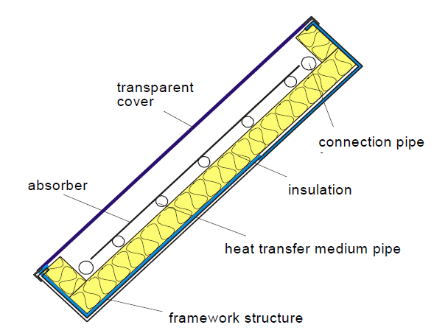
Non-Concentrating Collector

Slide 12
Applications of flat plate collectors
1. Solar water heating systems for residence, hotels, industry.
2. Desalination plant for obtaining drinking water from sea water.
3. Solar cookers for domestic cooking.
4. Drying applications.
5. Residence heating.

Slide 13
Concentrating Collectors
Energy delivery temperatures can be increased by decreasing the area from which the heat losses occur.
Temperatures far above those attainable by FPC can be reached if a large amount of solar radiation is concentrated on a relatively small collection area.
This is done by interposing an optical device between the source of radiation and the energy absorbing surface.
Concentrating collector is a device to collect solar energy with high intensity of solar radiation on the energy absorbing surface.
Such collectors use optical system in the form of reflectors or refractors.
The high temperature is achieved at absorber because of reflecting arrangement provided for concentrating the radiation at required location using mirrors and lenses.

Slide 14
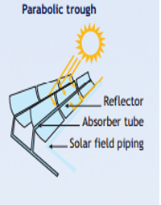
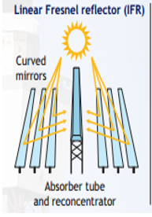
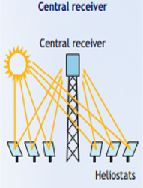
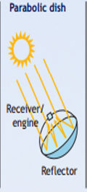
Concentrating Collectors

Slide 15
Solar Photovoltaic (SPV) System
SPV system convert solar energy directly into electrical energy.
Basic conversion device is SPV cell or solar cell.
A solar cell is basically an electrical current source, driven by a flux of radiation.
Life span is about 20 years.
To increase power, groups of solar cells are electrically connected and packaged into weather-tight modules and arrays to provide useful output voltages and currents for a specific power output.

Slide 16
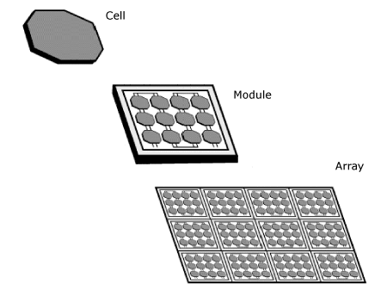
A SPV System typically consists of 3 basic components.
PV cells - Electricity is generated by PV cells, the smallest unit of a PV system.
Modules - PV cells are wired together to form modules which are usually a sealed, or encapsulated, unit of convenient size for handling.
Arrays – Groups of panels make up an array.

Slide 17
Applications
Space satellites
Remote radio communication booster stations
Marine warning lights
Lighting
Water pumping
Medical refrigeration in remote areas
Solar powered vehicles
Battery charging

Slide 18
Working Principle of Solar Cell
When light reaches the p-n junction, the light photons can easily enter in the junction, through very thin p-type layer.
The light energy, in the form of photons, supplies sufficient energy to the junction to create a number of electron-hole pairs.
The incident light breaks the thermal equilibrium condition of the junction. The free electrons in the depletion region can quickly come to the n-type side of the junction.
Similarly, the holes in the depletion can quickly come to the p-type side of the junction. Once, the newly created free electrons come to the n-type side, cannot further cross the junction because of barrier potential of the junction.

Slide 19
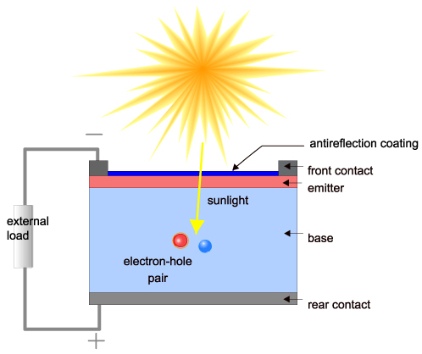
Similarly, the newly created holes once come to the p-type side cannot further cross the junction became of same barrier potential of the junction.
As the concentration of electrons becomes higher in one side, i.e. n-type side of the junction and concentration of holes becomes more in another side, i.e. the p-type side of the junction, the p-n junction will behave like a small battery cell.
A voltage is set up which is known as photo voltage. If we connect a small load across the junction, there will be a tiny current flowing through it.

Slide 20
2. Wind Power
Power is generated from the wind by converting the speed of the wind into electricity.
The faster the wind travels, the more electricity can be generated.
The main type of wind turbine design that work to generate power are horizontal axis wind turbine (HAWT).
Wind-power generation is the fastest growing energy source.

Slide 21
Wind turbines are good media for generating electricity from a clean and renewable resource for our homes and businesses. It comes with a couple of advantages for both humans and the environment, namely the following:
A wind turbine can harness a plentiful energy source, wind.
The use of wind electricity can cut our carbon footprint because it doesn't release any harmful gases or pollutants in the process of generating electricity.
The use of wind energy can cut our electricity bills because wind is free, and thus, after the payment for the initial installation, electricity costs will be reduced.
We can store energy even on a calm day. If our houses are not connected to the power grid, we can store the excess electricity produced from the wind turbine in batteries and use it when there is no wind.
We can sell electricity back to the grid, meaning if our wind system is producing more than what we need, someone else can use it, and thus, we can sell it.

Slide 22
Main Components of a Wind-turbine
1. Rotor
The portion of the wind turbine that collects energy from the wind is called the rotor.
The rotor usually consists of two or more wooden, fiberglass or metal blades which rotate about an axis (horizontal or vertical) at a rate determined by the wind speed and the shape of the blades.
The blades are attached to the hub, which in turn is attached to the main shaft.
It converts kinetic energy of wind into mechanical energy through a connected shaft.

Slide 23
2. Generator
The generator is that converts the turning motion of a wind turbine's blades into electricity.
Inside this component, coils of wire are rotated in a magnetic field to produce electricity.
The generator's rating, or size, is dependent on the length of the wind turbine's blades because more energy is captured by longer blades.
It is important to select the right type of generator to match intended use.

Slide 24
3. Transmission
The number of revolutions per minute (rpm) of a wind turbine rotor can range between some limits, depending on the model and the wind speed.
Most wind turbines require a gear-box transmission to increase the rotation of the generator to the speeds necessary for efficient electricity production.
Without a transmission, wind turbine complexity and maintenance requirements are reduced, but a much larger generator is required to deliver the same power output as the AC-type wind turbines.

Slide 25
4. Tower
The tower is the main shaft that connects the rotor to the foundation. It also raises the rotor height in the air where we can find stronger winds.
With HAWT, the tower houses the stairs to allow for maintenance and inspection.
The tower is the part on which a wind turbine is mounted. It is not just a support structure. It also raises the wind turbine so that its blades safely clear the ground and so it can reach the stronger winds at higher elevations.
Towers must be strong enough to support the wind turbine and to sustain vibration, wind loading and the overall weather elements for the lifetime of the wind turbine.
Their costs will vary widely as a function of design and height.

Slide 26
5. Gearbox-
The gearbox alters the rotational velocity of the shaft to suit the generator.
6. Control and protection system-
The protection system is like a safety feature that makes sure that the turbine will not be working under dangerous condition. This includes a brake system triggered by the signal of higher speeds to stop the rotor from movement under excessive wind gusts.
7. Foundation-
The foundation or the base supports the entire wind turbine and make sure that it is well fixed onto the ground or the roof for small household wind turbines. This usually consists of a solid concrete assembly around the tower to maintain its structural integrity.

Slide 27
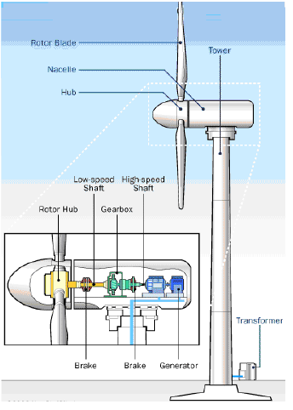

Slide 28
Working
A equipment found on the weather tight compartment at the top of a tower of an HAWT, called nacelle.
The slow rotation of the shaft of an HAWT is normally increased with a gearbox and passed to the generator.
Gearbox and generator are attached directly to the turbine shaft though a braking system.
The electricity produced from the generator is taken with cables through the tower to a substation and eventually to the grid.
The rotor, gearbox and generator are mounted on a platform which is able to rotate or yaw about a vertical axis so that the rotor shaft is perpendicular to the wind direction.

Slide 29
THANK YOU

